Slide 1

AGRICULTURAL DRONE SIMULATOR
GUIDED BY -: SANDEEP KUMAR
(3D Assets)

Slide 2
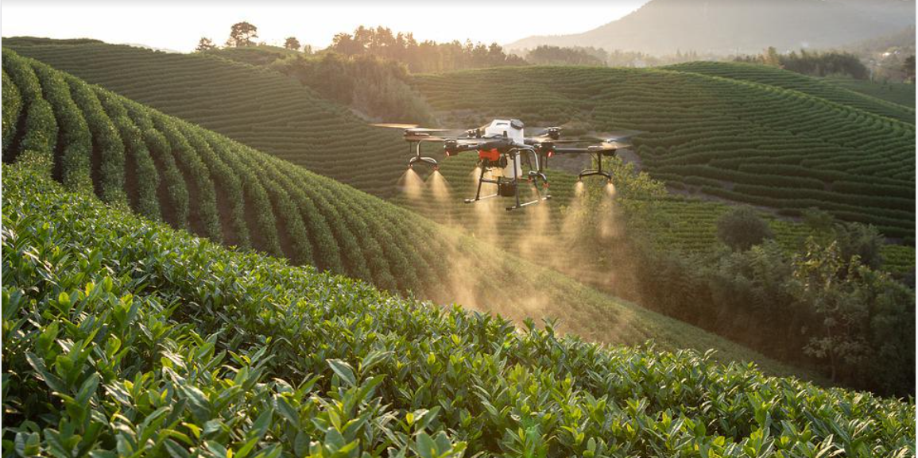

Slide 3
CONTENTS
1. Introduction
2. Advantages
3. Limitations
4. Requirements
5. About To-Do
6. Experience

Slide 4
INTRODUCTION
Drones - Refers to unpiloted aircraft or spacecraft, another term for it is an "unmanned aerial vehicle" or UAV
An agricultural drone is an UAV used for agriculture operations, mostly used in yield optimization and in monitoring crop growth and production
It can access hard-to-reach places
Decrease labor work
Don't require rest, enabling them to fly as long as it is provided with an energy source and there are no mechanical difficulties

Slide 5
BENEFITS TO FARMERS
CROP MONITORING
PLANTATION
CROP PROTECTION
PRODUCTIVITY RISE
TIME SAVING
LIVESTOCK MANAGEMENT
1
2
3
4
5
6
7
8
9
10
11
12
SOIL & FIELD ANALYSIS
CROP SPRAYING
LOCUST CONTROL
CHECK CROP HEALTH
AVOID CHEMICAL OVERUSE
PREPARE FOR WEATHER GLITCHES

Slide 6
ADVANTAGES OF SIMULATOR APP
Simulated UAVs: The system allows to gain some training experience for the UAVs
Actual ground station: The system uses real data generated by the actual UAV to provide an extremely realistic simulation
Virtual world: Here, the UAV flies are modelled in 3D with photo textures, and contains all the necessary features to simulate a mission in operational conditions
Payload simulation: The system generates real-time video to simulate the payload output in both visible and IR modes. This video is piped to the actual video station as in the real system
Simulation features: Multilingual interface, VCR type controls (replay forward / backward)
Components: Through this application, we can gain proper knowledge about each and every component attached to it

Slide 7
LIMITATIONS
CONNECTIVITY ISSUE
Online coverage is unavailable in rural areas. So, a farmer needs to invest in internet connectivity, which can turn into a recurring expense
EXPENSIVE
Drones having long flight time, long range and more advanced features are also costlier
C
E
An average farmer may struggle to understand its functions. Either he must acquire the knowledge or remain dependent on an experienced person
KNOWLEDGE & SKILL
Heavily dependent on good weather conditions. Under rainy or windy weather conditions, it is not advisable to fly
WEATHER DEPENDENT
K
W

Slide 8
REQUIREMENTS
16 GB RAM
Unity
Hardware
Software
4 GB Graphics card
Blender

Slide 9
ABOUT TO-DO
Better UI design
Pre-post processing
Better swervying
1
3
5
2
4
6
Adding controllers
Image pre-processing
Final AR application building

Slide 10
EXPERIENCE
Developing our skills in new areas
Getting opportunity to learn new skills within our university
Proper utilization of time with a perfect guide in a better way
Learning to design and develop our own application for different platforms

Slide 11
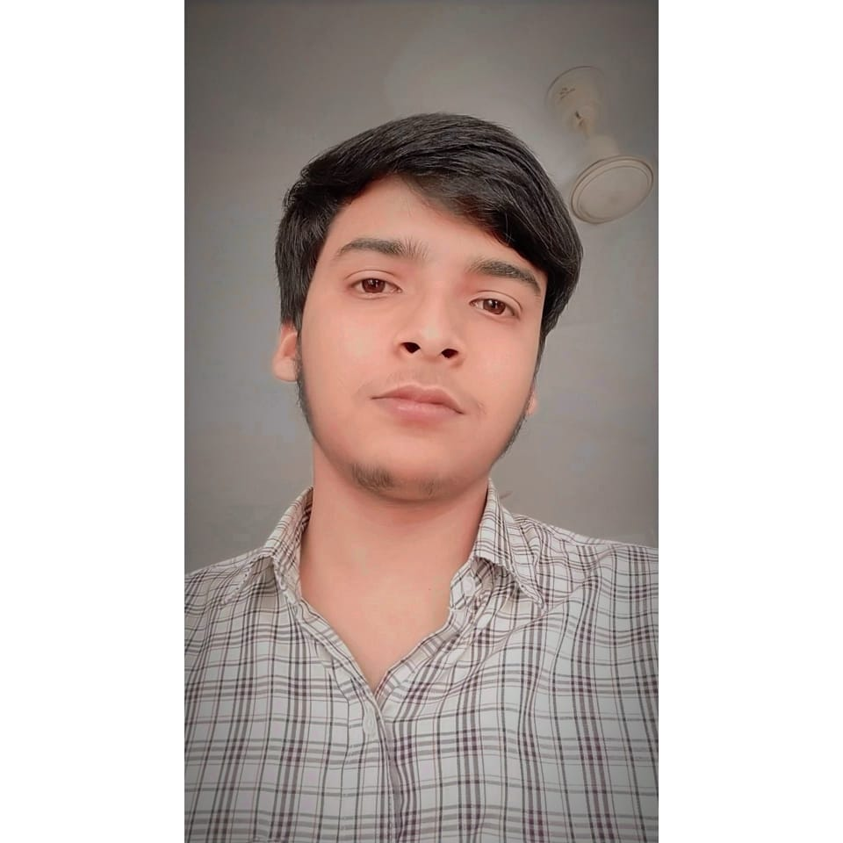
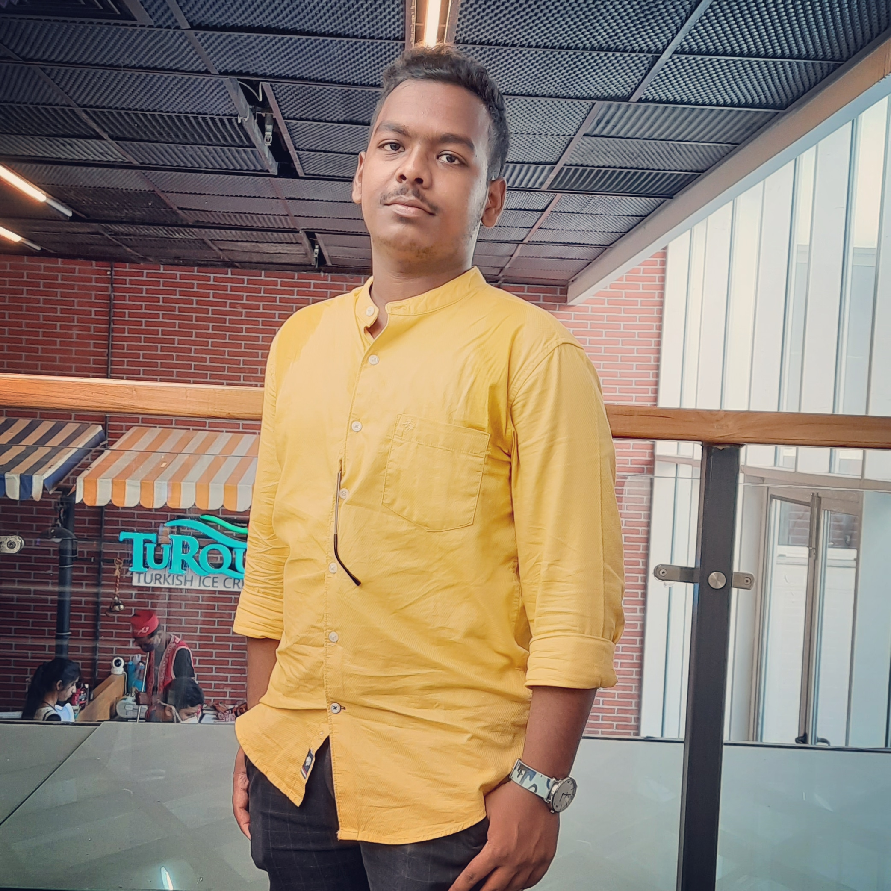
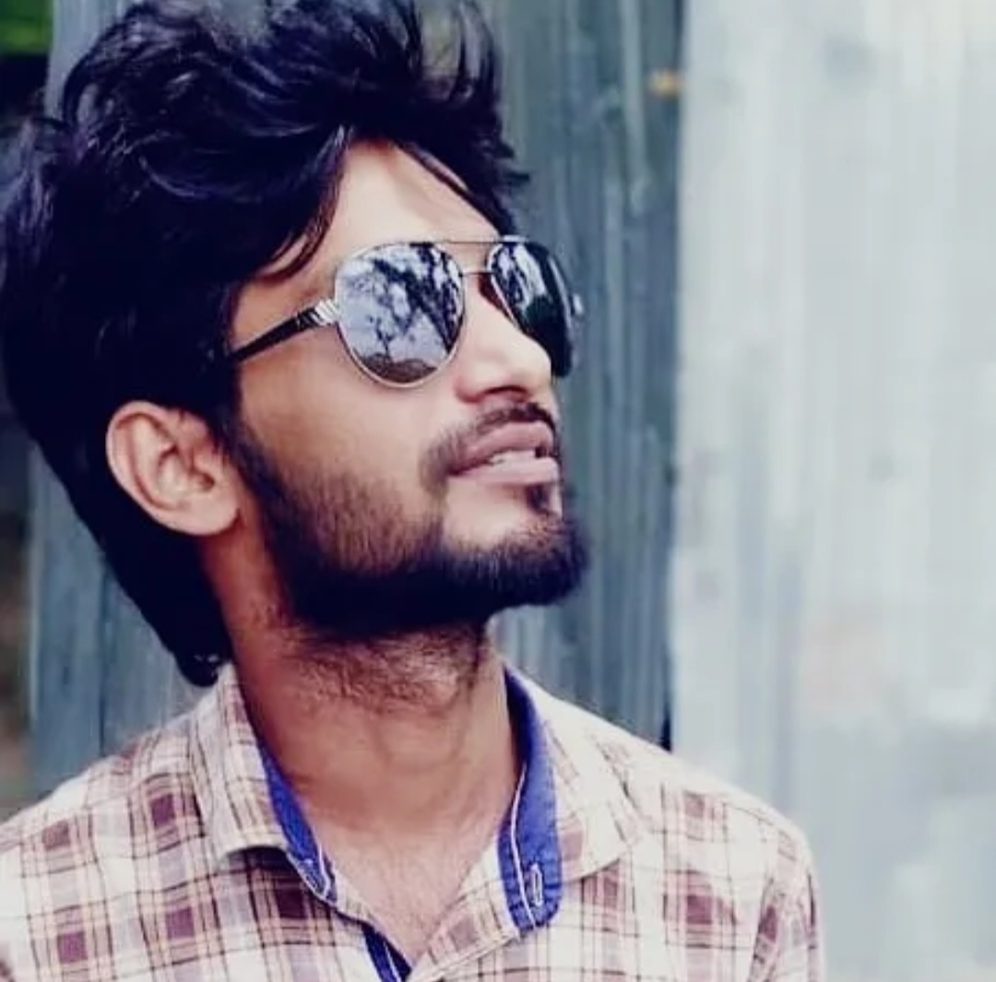
TEAM PRESENTATION
KIRTTIRAJ SAHOO 200301120070
B.TECH - CSE
P SUDIP KUMAR PRUSTY 200301120183
B.TECH - CSE
SANDEEP KUMAR GUIDE
GAME DEVELOPER & 3D ARTIST

Slide 12
THANKS !
Any questions ?

